Slide 1

Hybrid File Integrity Monitoring (FIM) using PowerShell
Purple Team Simulation – Attack & Defense
Name & Intern ID : Shivani Yadav 279
Samiksha Patil 280
Chaitali Patil 297

Slide 2
Introduction to File Integrity Monitoring (FIM)
File Integrity Monitoring (FIM) is a security process that involves validating the integrity of operating system and application software files by comparing current file characteristics with a known, trusted baseline. If any deviations are detected, an alert is triggered.
In cybersecurity, integrity is paramount. Tampering with critical files can lead to data breaches, system compromise, or service disruption, posing significant risks to an organisation. FIM acts as an early warning system.
This presentation explores a Purple Team approach, simulating both the attack (file tampering) and defense (FIM detection) to demonstrate the effectiveness of our PowerShell-based solution.

Slide 3
Key Objectives of Our FIM Solution
1
2
Real-time Event Detection
SHA256 Integrity Verification
Monitor and promptly detect file system events such as creation, modification, renaming, and deletion of files within specified directories.
Utilise SHA256 hashing to verify file integrity. Any change to a file's content will result in a different hash, indicating tampering.
3
4
Comprehensive Logging
Attack Simulation & Monitoring
Maintain detailed logs of all detected changes, including timestamp, user responsible for the change, and the full file path for audit and incident response.
Facilitate the simulation of attacker actions (e.g., modifying critical files) and effectively monitor these activities through the FIM system.

Slide 4



How It Works
Event-Driven Detection
Hash Polling Loop
Combined Approach
Leverages PowerShell's FileSystemWatcher to detect real-time file system events such as file creation, modification, renaming, and deletion.
Periodically calculates and compares SHA256 hashes of files in the watched folder against a baseline to detect subtle content changes.
By integrating both methods, we achieve a hybrid FIM solution that is more resilient and capable of detecting a wider range of tampering attempts.

Slide 5
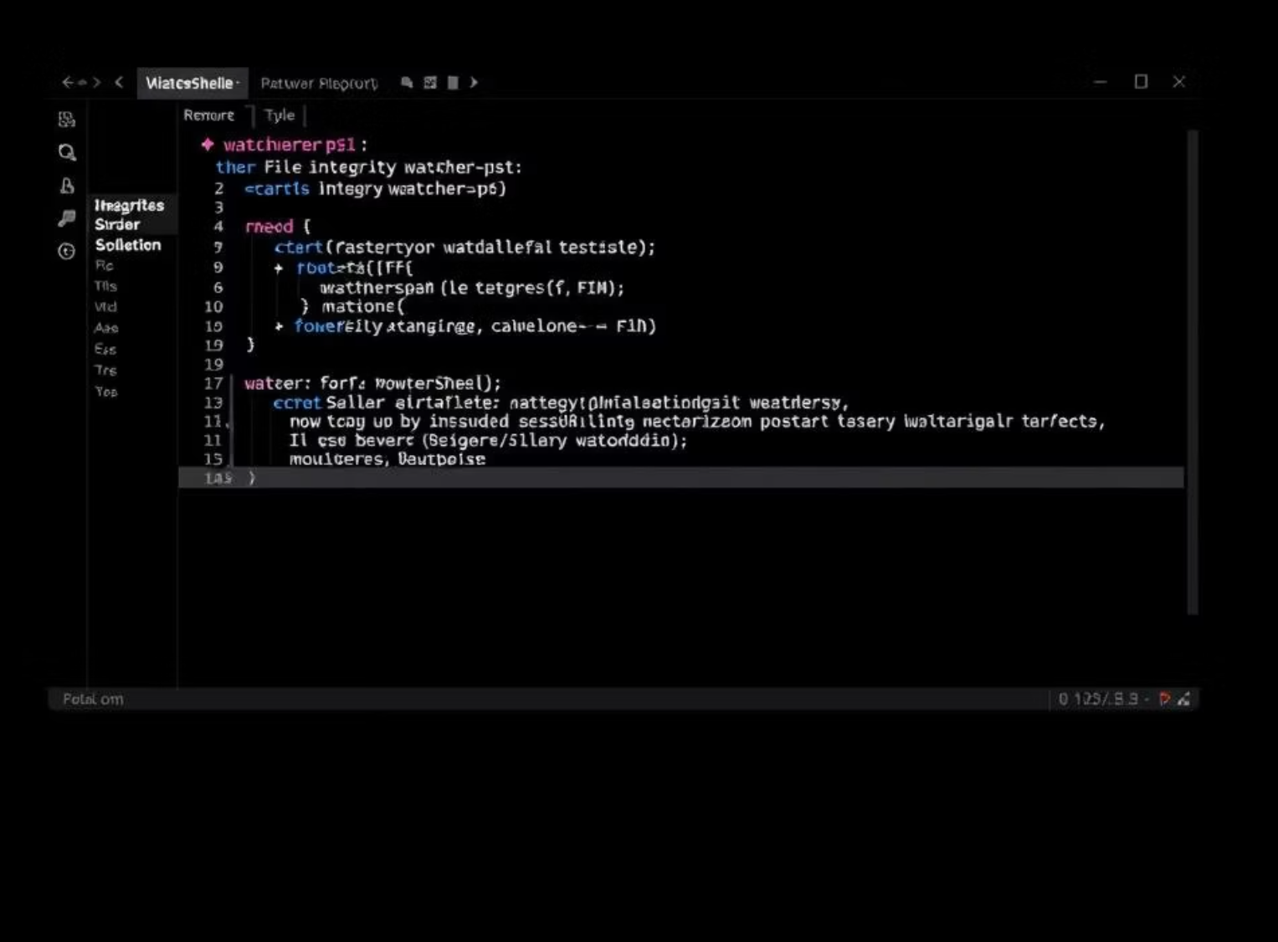
Implementation Steps
Set up the defined folder structure (watched, logs, ReportArtifacts).
Execute the watcher.ps1 PowerShell script to initiate monitoring.
Perform various file actions (create, modify, rename, delete) within the watched folder.
Observe the fim_log.txt in the logs folder for real-time updates and recorded events.

Slide 6
Purple Team Simulation: Attack and Defense
Attacker Side: Simulating Threats
Defender Side: Real-time Detection
We simulate common attacker tactics, such as unauthorised file creation, modification, or deletion, akin to ransomware activity or an insider threat attempting to exfiltrate or corrupt data. These actions are performed directly on the watched folder.
Our PowerShell FIM script acts as the defender, actively monitoring the watched folder. It logs every event and integrity change, providing immediate visibility into malicious activities.

Slide 7
Results & Benefits
Real-time Detection: Instant alerts on file activities.
Cryptographic Verification: Confirmed content integrity via SHA256.
Audit-Ready Logs: Usable for investigations and compliance.
Cost-Free FIM: Simple and effective FIM using PowerShell.

Slide 8
Conclusion
This project demonstrates how FIM works in real-world security scenarios, providing immediate and verifiable insights into file integrity.
The hybrid approach, combining real-time event watching with periodic hashing, offers a robust and comprehensive detection capability.
It provides both an attacker's and defender's perspective, essential for effective Purple Teaming and enhancing overall cybersecurity posture.

Slide 9
Thank You

